Slide 1
Strongly Connected Components
Nahian Salsabil

Slide 2
Strongly Connected Components
We now consider a classic application of depth-first search: decomposing a directed graph into its strongly connected components.
We will see how to do so using two depth-first searches.

Slide 3
Strongly Connected Components
Strongly Connected Components are subsets of vertices within a directed graph where every vertex is reachable from every other vertex in the subset. In simpler terms, it represents a group of nodes that can reach each other through directed paths.

Slide 4
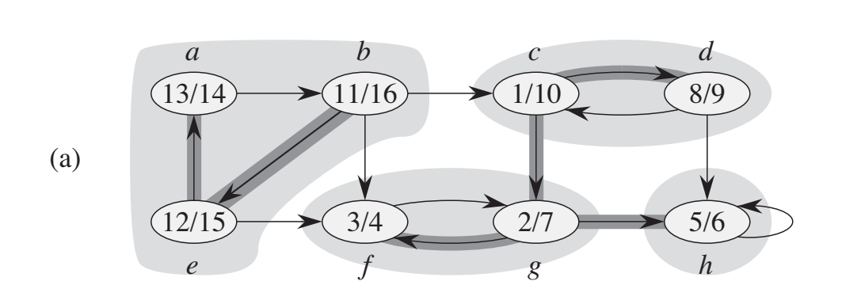
Strongly Connected Components
Each shaded region is a strongly connected component

Slide 5
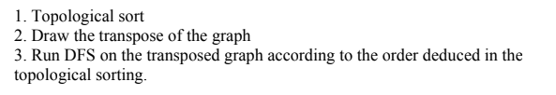
Strongly Connected Components

Slide 6
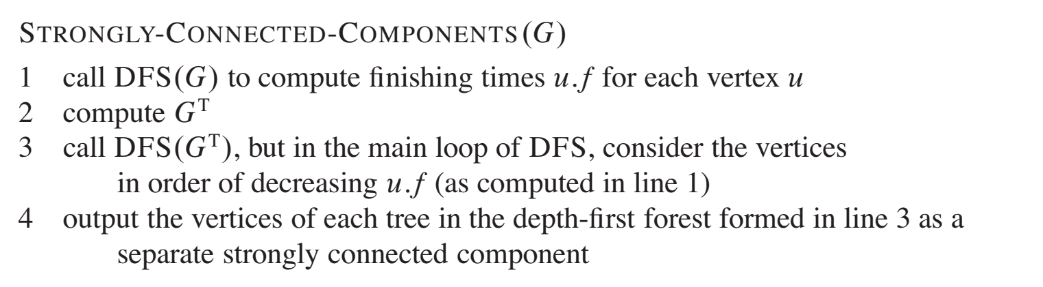
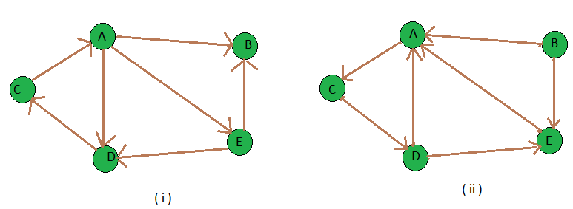
Transpose of the Graph
Transpose of a directed graph G is another directed graph on the same set of vertices with all of the directions reversed

Slide 7
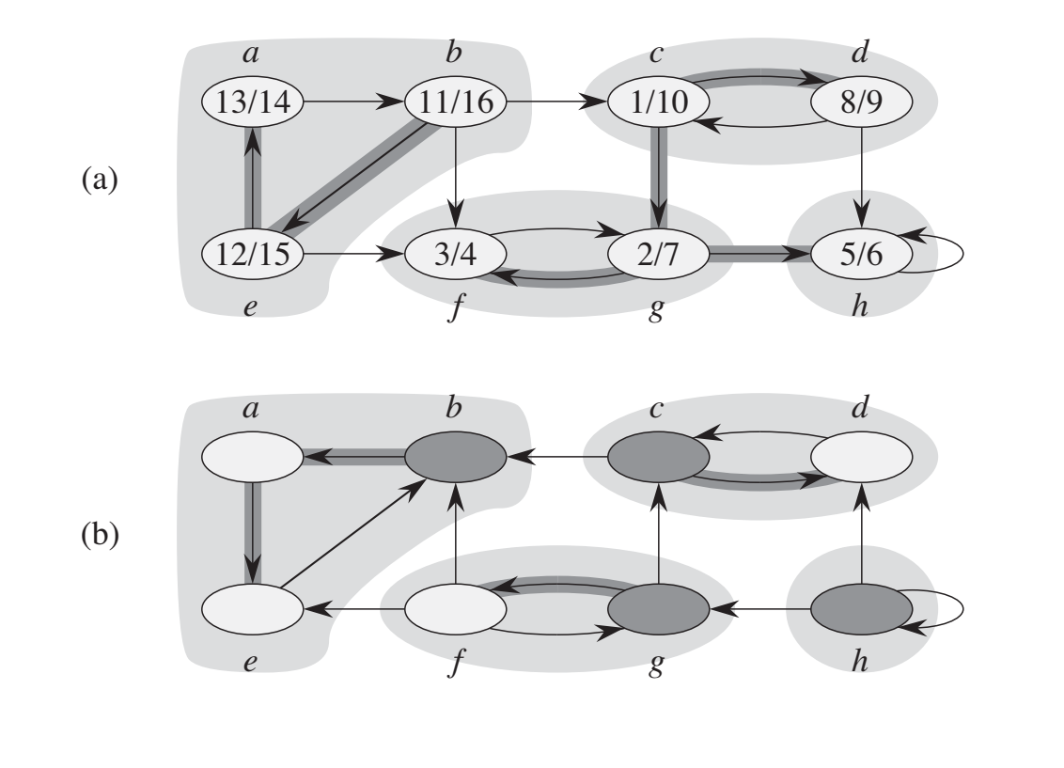
Strongly Connected Components
Top Sort: b, e, a, c, d, g, h, f

Slide 8
Strongly Connected Components
Transpose

Slide 9
Strongly Connected Components
b
Top Sort:
b, e, a, c, d, g, h, f
Starting DFS from here →

Slide 10
Strongly Connected Components
ba
Top Sort:
b, e, a, c, d, g, h, f

Slide 11
Strongly Connected Components
bae
Top Sort:
b, e, a, c, d, g, h, f

Slide 12
Strongly Connected Components
bae
Top Sort:
b, e, a, c, d, g, h, f

Slide 13
Strongly Connected Components
bae
c
Top Sort:
b, e, a, c, d, g, h, f

Slide 14
Strongly Connected Components
bae
cd
Top Sort:
b, e, a, c, d, g, h, f

Slide 15
Strongly Connected Components
bae
cd
Top Sort:
b, e, a, c, d, g, h, f

Slide 16
Strongly Connected Components
bae
cd
Top Sort:
b, e, a, c, d, g, h, f

Slide 17
Strongly Connected Components
bae
cd
Top Sort:
b, e, a, c, d, g, h, f
g

Slide 18
Strongly Connected Components
bae
cd
Top Sort:
b, e, a, c, d, g, h, f
gf

Slide 19
Strongly Connected Components
bae
cd
Top Sort:
b, e, a, c, d, g, h, f
gf

Slide 20
Strongly Connected Components
bae
cd
Top Sort:
b, e, a, c, d, g, h, f
gf
h

Slide 21
Strongly Connected Components
bae
cd
Top Sort:
b, e, a, c, d, g, h, f
gf
h

Slide 22
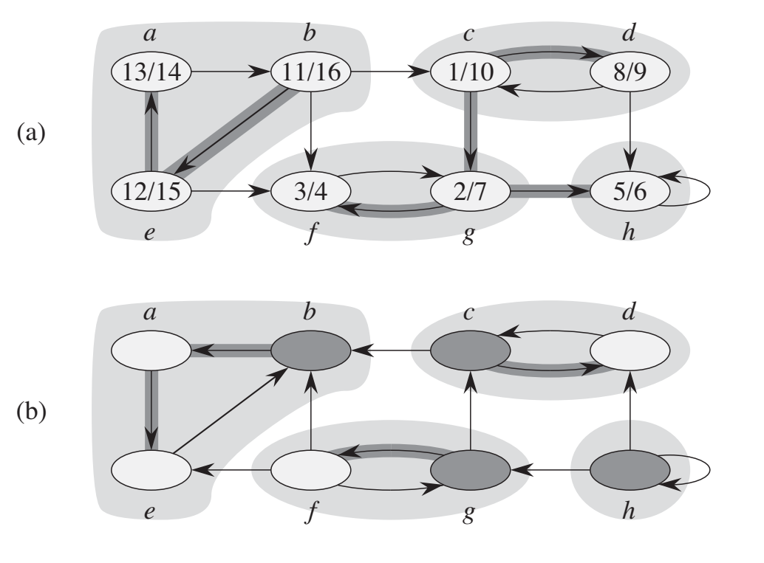
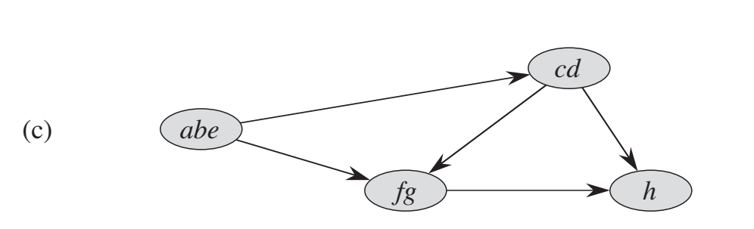
Strongly Connected Components

Slide 23
Code
def dfs_visit(node, graph, visited, stack):
visited[node] = True
for neighbor in graph[node]:
if not visited[neighbor]:
dfs_visit(neighbor, graph, visited, stack)
stack.append(node)
def dfs_scc(node, graph, visited, scc):
visited[node] = True
scc.append(node)
for neighbor in graph[node]:
if not visited[neighbor]:
dfs_scc(neighbor, graph, visited, scc)
def transpose_graph(graph):
transposed_graph = {node: [] for node in graph}
for node in graph:
for neighbor in graph[node]:
transposed_graph[neighbor].append(node)
return transposed_graph
def strongly_connected_components(graph):
num_nodes = len(graph)
visited = [False] * num_nodes
stack = []
for node in range(num_nodes):
if not visited[node]:
dfs_visit(node, graph, visited, stack)
transposed_graph = transpose_graph(graph)
visited = [False] * num_nodes
strongly_connected_components = []
while stack:
node = stack.pop()
if not visited[node]:
scc = []
dfs_scc(node, transposed_graph, visited, scc)
strongly_connected_components.append(scc)
return strongly_connected_components
The stack is used to store the nodes in reverse order of their finishing time

Slide 24
# Example usage:
if __name__ == "__main__":
# Sample graph represented as an adjacency list
graph = {
0: [1],
1: [2],
2: [0, 3],
3: [4],
4: [3]
}
result = strongly_connected_components(graph)
print(result) # Output: [[4, 3], [2, 1, 0]]

